Slide 1


micro:bit entry video tutorial
Lesson 9
micro:bit sensor lesson 9 “Small speaker”
YahBoom micro:bit module tutorial

Slide 2
micro:bit entry video tutorial
Content
Part1
Part 2
Part3
Part 4
Part 5
Learning goals
Preparation
Connection
Search for blocks
Combine blocks
YahBoom micro:bit module tutorial

Slide 3
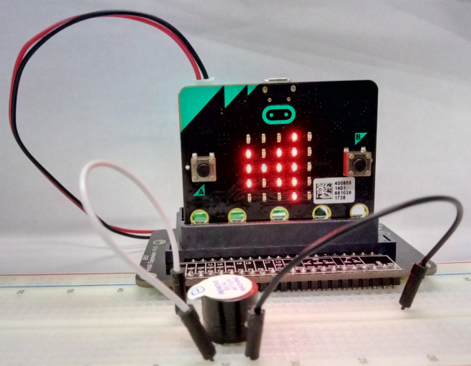
micro:bit entry video tutorial
Part 1
Learning goals
After you download the program, press the A button, you can hear the buzzer's "tick", and there will be a small horn flashing on the screen.
YahBoom micro:bit module tutorial

Slide 4
micro:bit entry video tutorial
Part 2
Hardware:
● 1 X Micro: bit Board
● 1 X Micro:bit breakout
● 2 X Male to male cable
● 1 X Micro USB Cable
● 1 X Active buzzer
● 1 X PC
Preparation
Then the micro:bit is connected to the computer through USB, and the computer will pop up a U disk and click the URL in the U disk to enter the programming interface. Input this URL https://github.com/lzty634158/yahboom_mbit_en to get the package.
YahBoom micro:bit module tutorial

Slide 5
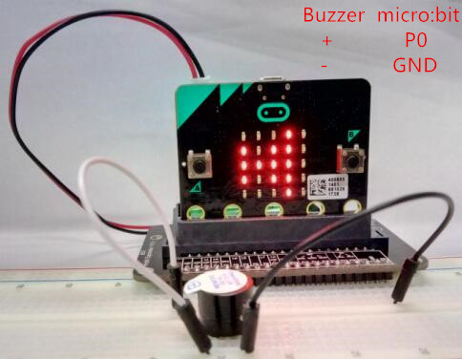
micro:bit entry video tutorial
Part 3
The children need to move their own small fingers, connecting the P0 pins on the micro:bit extension board to the positive pole of the buzzer with DuPont line, connecting the GND pins on the micro:bit extension board to the negative pole of the buzzer.
Our buzzer is on top of the breadboard. The long pin of the buzzer is the positive pole, the short pin is the negative pole, and the "+" corresponds to the positive pole on the label paper.
Connection
YahBoom micro:bit module tutorial

Slide 6
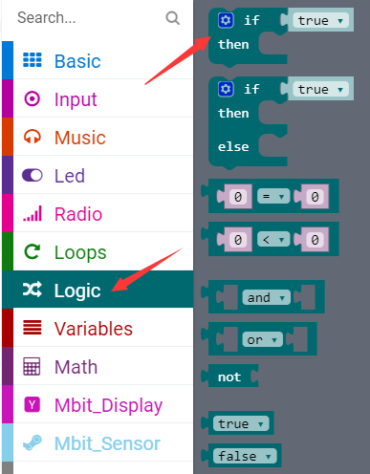
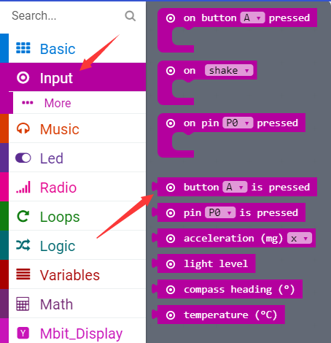
micro:bit entry video tutorial
Part 3
Search for blocks
YahBoom micro:bit module tutorial

Slide 7
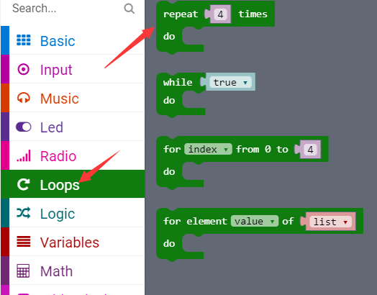
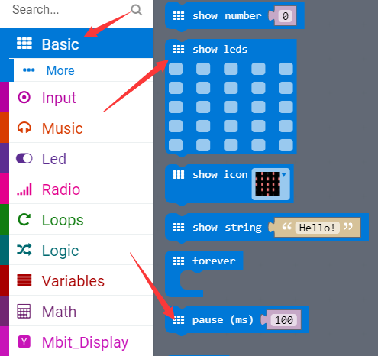
micro:bit entry video tutorial
Part 4
Search for blocks
YahBoom micro:bit module tutorial

Slide 8
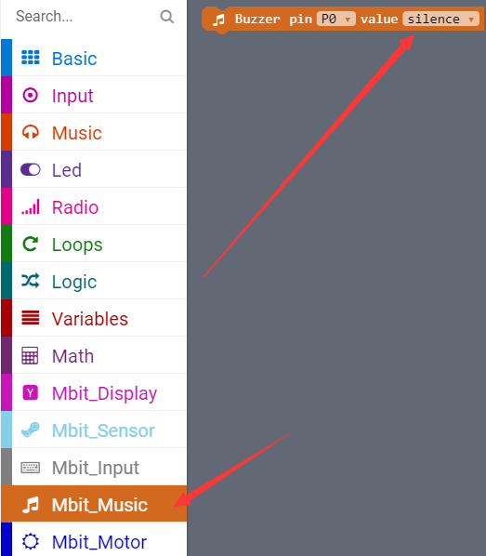
micro:bit entry video tutorial
Part 4
Search for blocks
YahBoom micro:bit module tutorial

Slide 9
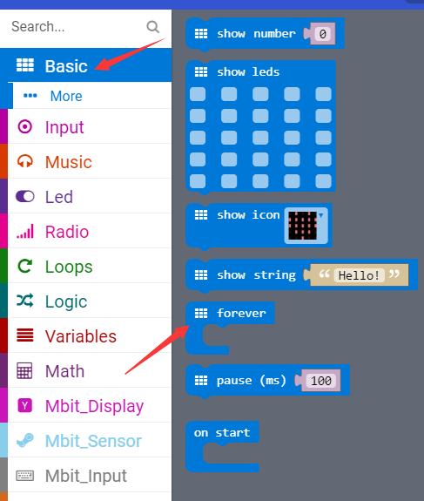
micro:bit entry video tutorial
Part 4
Search for blocks
YahBoom micro:bit module tutorial

Slide 10
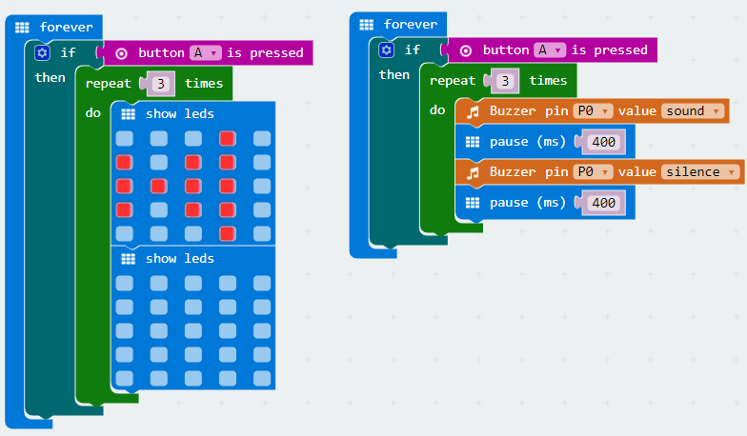
micro:bit entry video tutorial
Part 5
Combine blocks
YahBoom micro:bit module tutorial

Slide 11
micro:bit entry video tutorial
micro:bit
project
Thanks for watching！
Powered by YahBoom
YahBoom micro:bit module tutorial

